Slide 1
跟着Kevin学英语(7)
Piggy in the Middle

Slide 2
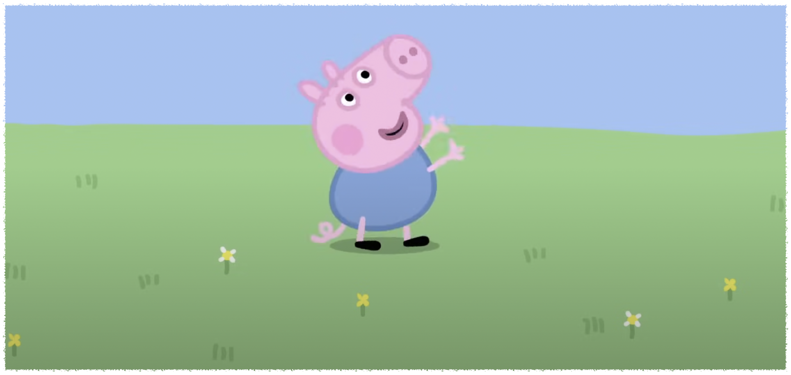
G g
Garden
Game
Notes:
George is playing in the garden

Slide 3
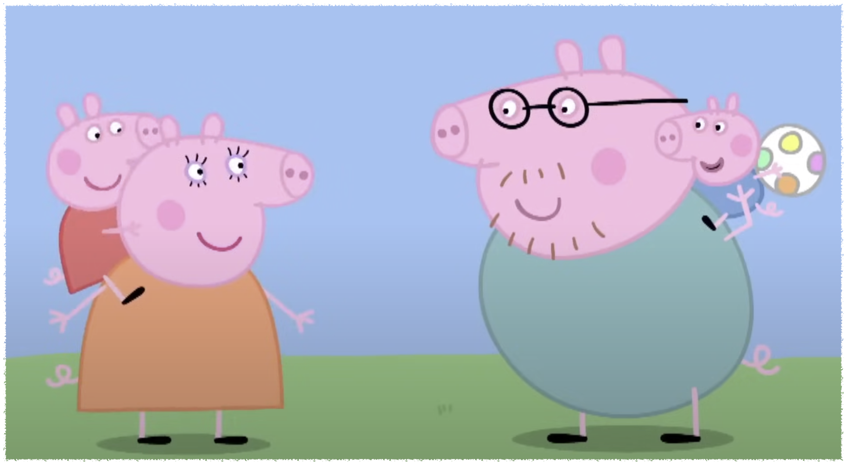
G g
Garden
Game
Notes:
They are playing a game

Slide 4
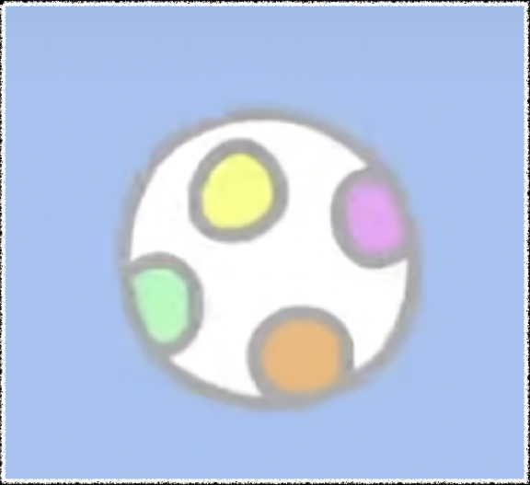
B b
Ball
Notes:
He likes playing the ball

Slide 5
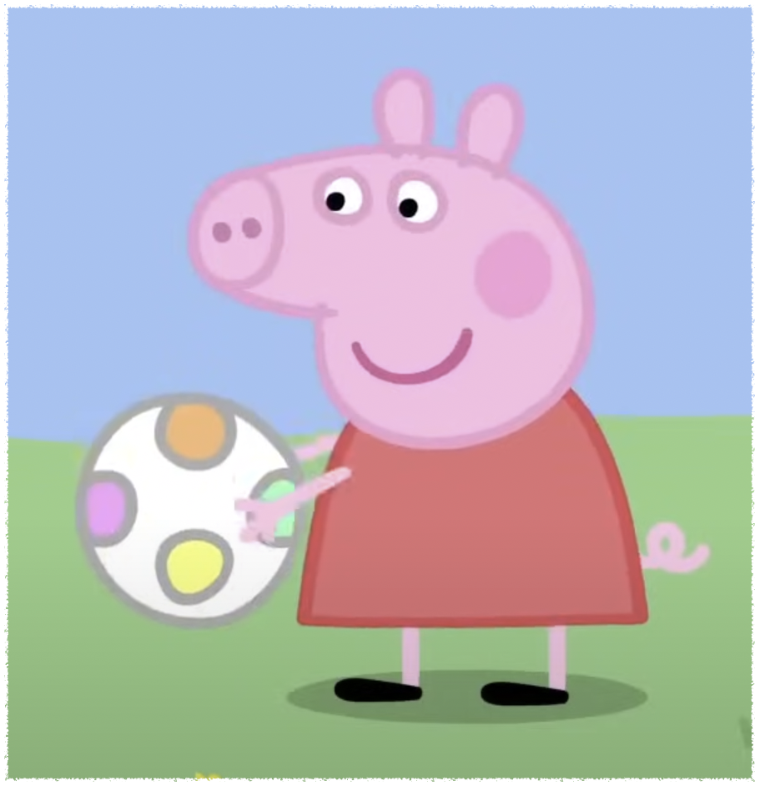
C c
Catch
Notes:
She can catch the ball

Slide 6
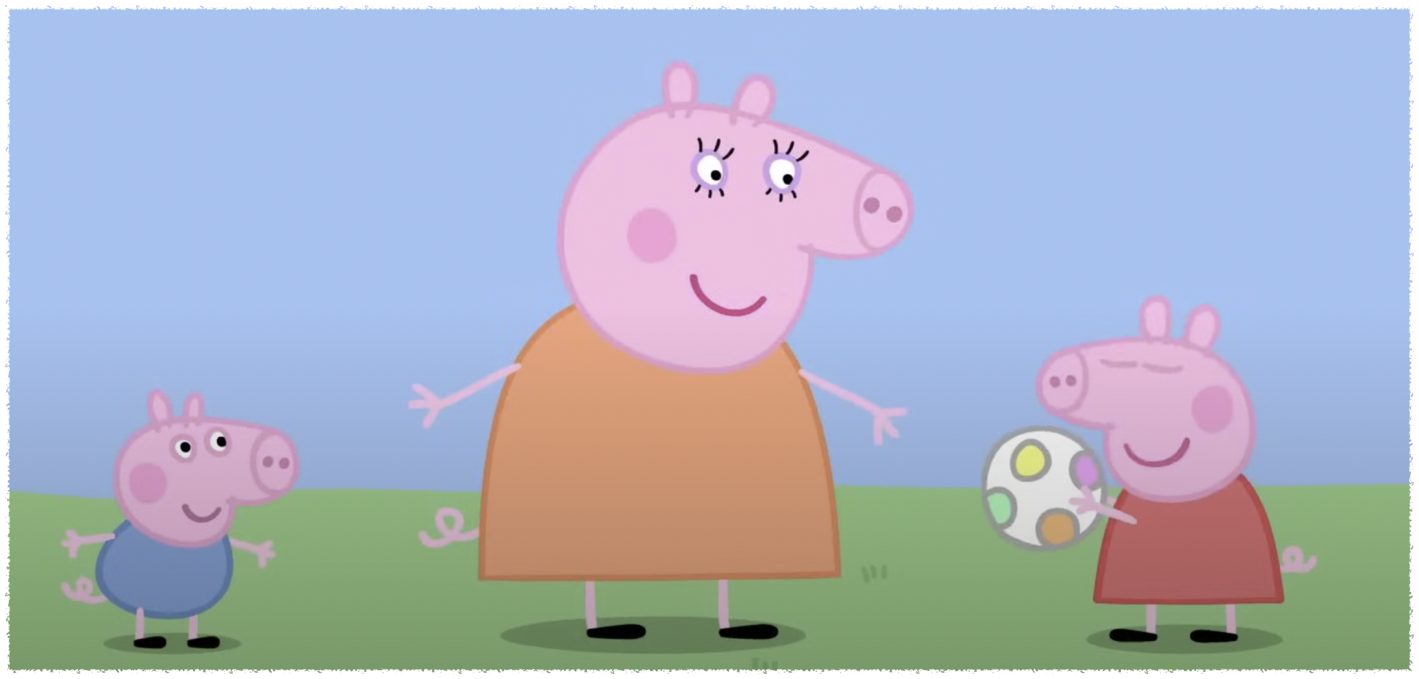
M m
Middle
Notes:
Mommy pig is in the middle

Slide 7
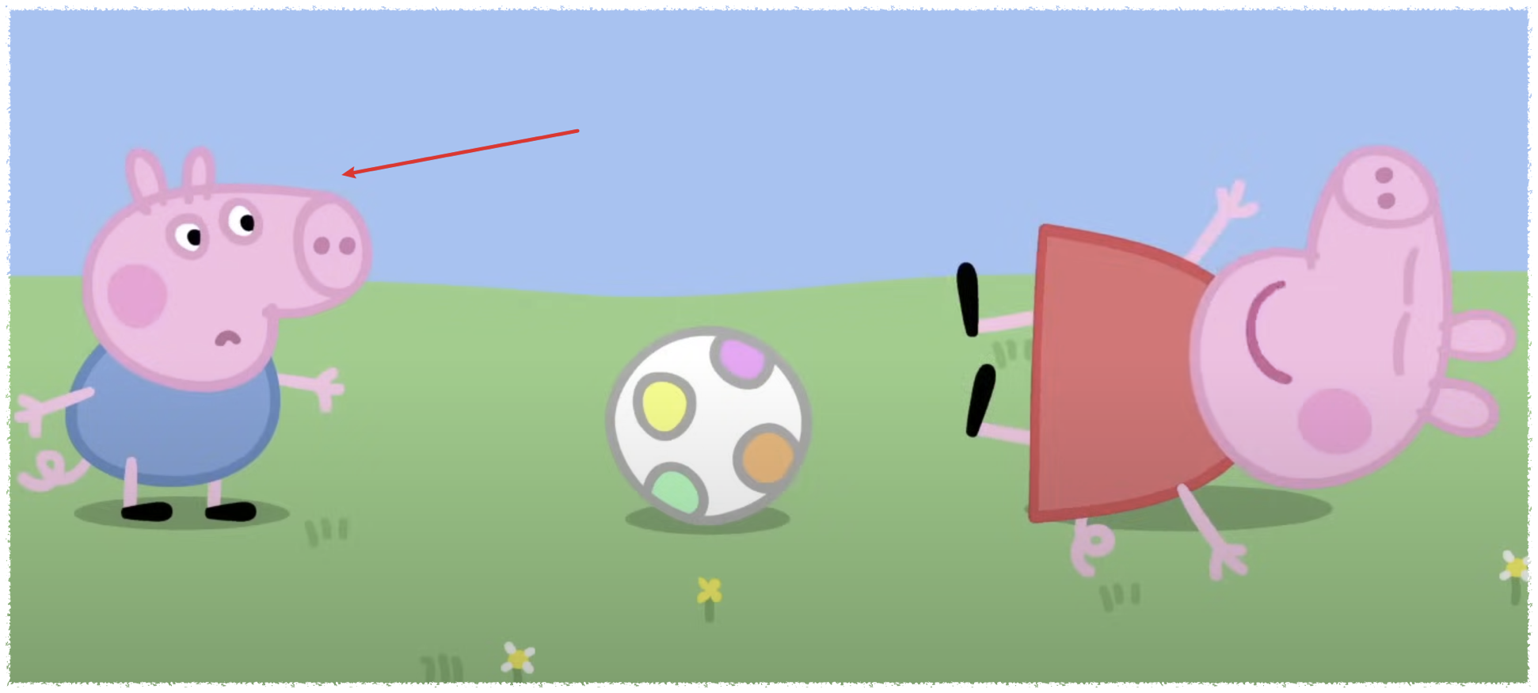
S s
Stand
Notes:
He is standing

Slide 8
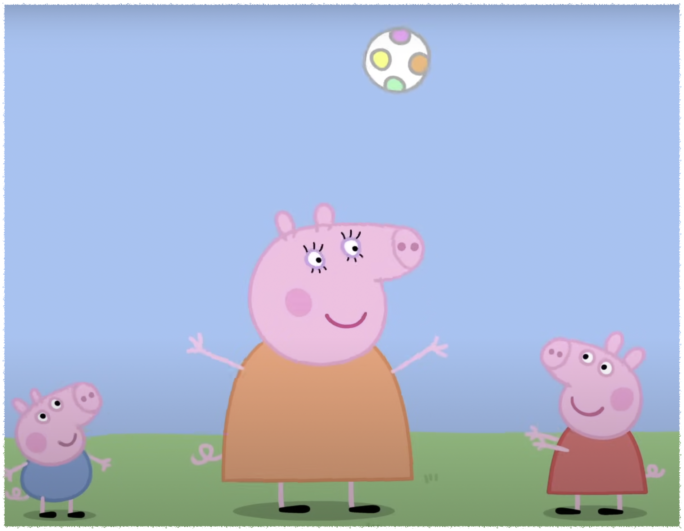
T t
Throw
Notes:
She can throw the ball

Slide 9
Come back
You stand over there
Well done
That's not fair
Try again

